Slide 1
Ch.9 Hypothesis Testing (가설검정)
Updated: December 13, 2016
Choi, Kwanghoon
Dept. of Electronics and Computer Engineering
Chonnam National University

Slide 2
This Lecture
Hypothesis Testing(가설검정)
Observed statistic vs. interval estimate
Significance level observed vs. Significance level basis

Slide 3
9.1 Hypothesis Testing(가설 검정)
What is the meaning of an Interval estimate with degree of confidence 100(1-α)%?

Slide 4
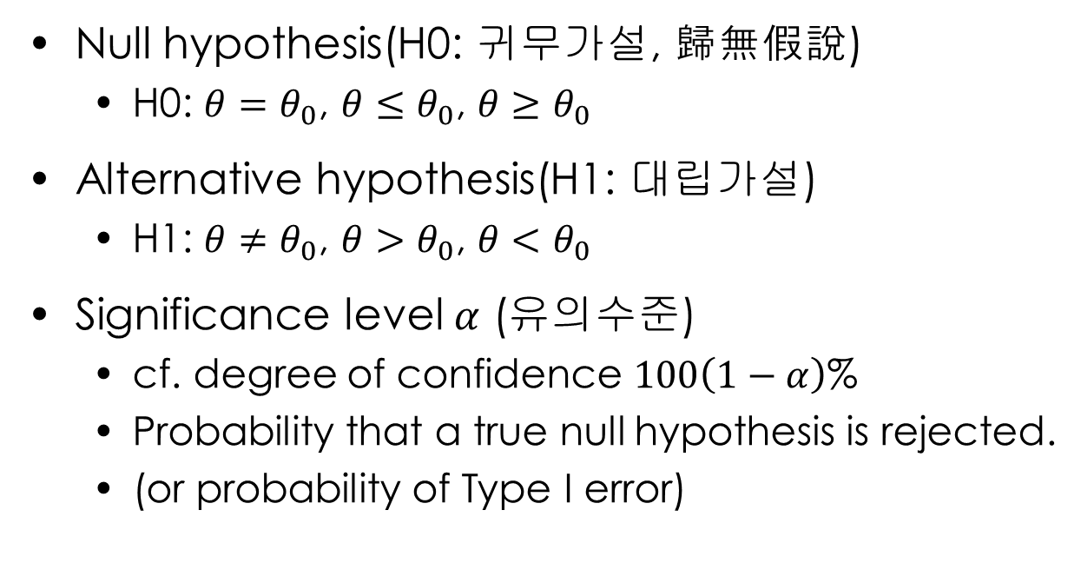
9.1 Hypothesis Testing(가설 검정)
Null hypothesis(H0: 귀무가설, 歸無假說)
H0: $θ=θ_{0}$, $θ≤θ_{0}$, $θ≥θ_{0}$
Alternative hypothesis(H1: 대립가설)
H1: $θ≠θ_{0}$, $θ{>θ}_{0}$, $θ<θ_{0}$
Significance level $α$ (유의수준)
cf. degree of confidence $100\left(1−α\right)$%
Probability that a true null hypothesis is rejected.
(or probability of Type I error)

Slide 5
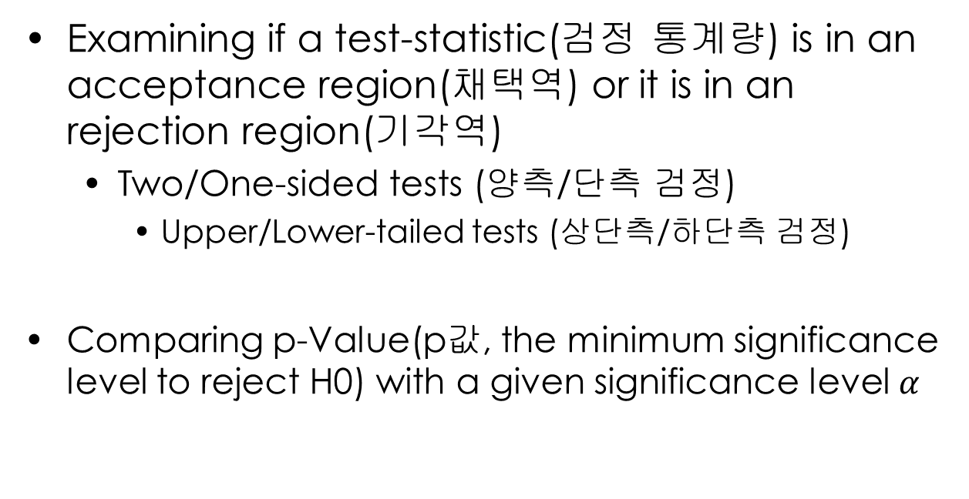
9.1 Hypothesis Testing(가설 검정)
Examining if a test-statistic(검정 통계량) is in an acceptance region(채택역) or it is in an rejection region(기각역)
Two/One-sided tests (양측/단측 검정)
Upper/Lower-tailed tests (상단측/하단측 검정)
Comparing p-Value(p값, the minimum significance level to reject H0) with a given significance level $α$

Slide 6

9.2 Population Mean Testing(모평균 검정)
Activity 1 (예제1,2,3)
양측,하단측,상단측 검정
Hint: $\overline{X}\sim N(μ,\frac{σ^{2}}{n})$

Slide 7
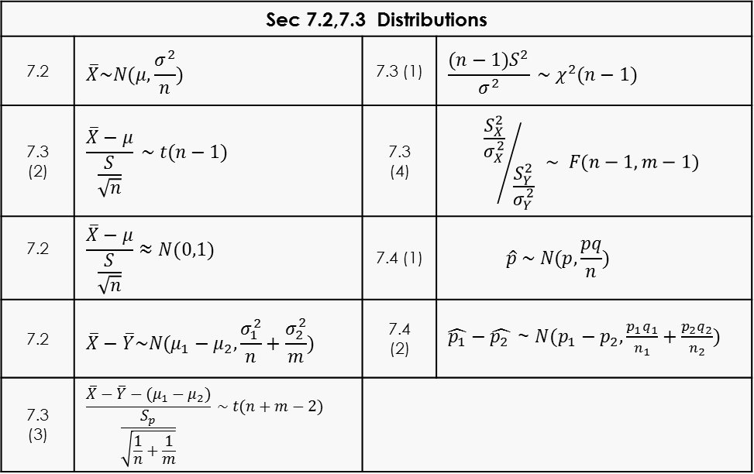
9.2 Population Mean Testing(모평균 검정)
A series of probability distributions of statistics obtained from samples
Sec 7.2,7.3 Distributions
7.2 | $$\overline{X}\sim N(μ,\frac{σ^{2}}{n})$$ | 7.3 (1) | $$\frac{(n−1)S^{2}}{σ^{2}} \sim χ^{2}(n−1)$$
7.3 (2) | $$\frac{\overline{X}−μ}{\frac{S}{\sqrt{n}}} \sim t(n−1)$$ | 7.3 (4) | $${\frac{S_{X}^{2}}{σ_{X}^{2}}}/{\frac{S_{Y}^{2}}{σ_{Y}^{2}}} \sim F(n−1,m−1)$$
7.2 | $$\frac{\overline{X}−μ}{\frac{S}{\sqrt{n}}}≈N(0,1)$$ | 7.4 (1) | $$\hat{p} \sim N(p,\frac{pq}{n})$$
7.2 | $$\overline{X}−\overline{Y}\sim N(μ_{1}−μ_{2},\frac{σ_{1}^{2}}{n}+\frac{σ_{2}^{2}}{m})$$ | 7.4 (2) | $\hat{p_{1}}−\hat{p_{2} }$~ $N(p_{1}−p_{2},\frac{p_{1}q_{1}}{n_{1}}+\frac{p_{2}q_{2}}{n_{2}})$
7.3 (3) | $$\frac{\overline{X}−\overline{Y}−(μ_{1}−μ_{2})}{\frac{S_{p}}{\sqrt{\frac{1}{n}+\frac{1}{m}}}} \sim t(n+m−2)$$

Slide 8
9.2 Population Mean Testing(모평균 검정)
T-test
Activity 2 (예제4,5,6)
양측,하단측,상단측 검정
Analysis of paired sample(쌍체 표본)
Tests on the difference of two values in a pair
Activity 3 (교재 예제 p.374)

Slide 9
9.3 Population Proportion Testing(모비율 검정)
Activity 1 (예제1,2,3)

Slide 10
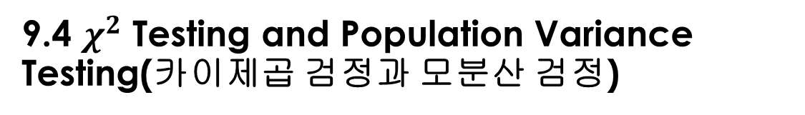
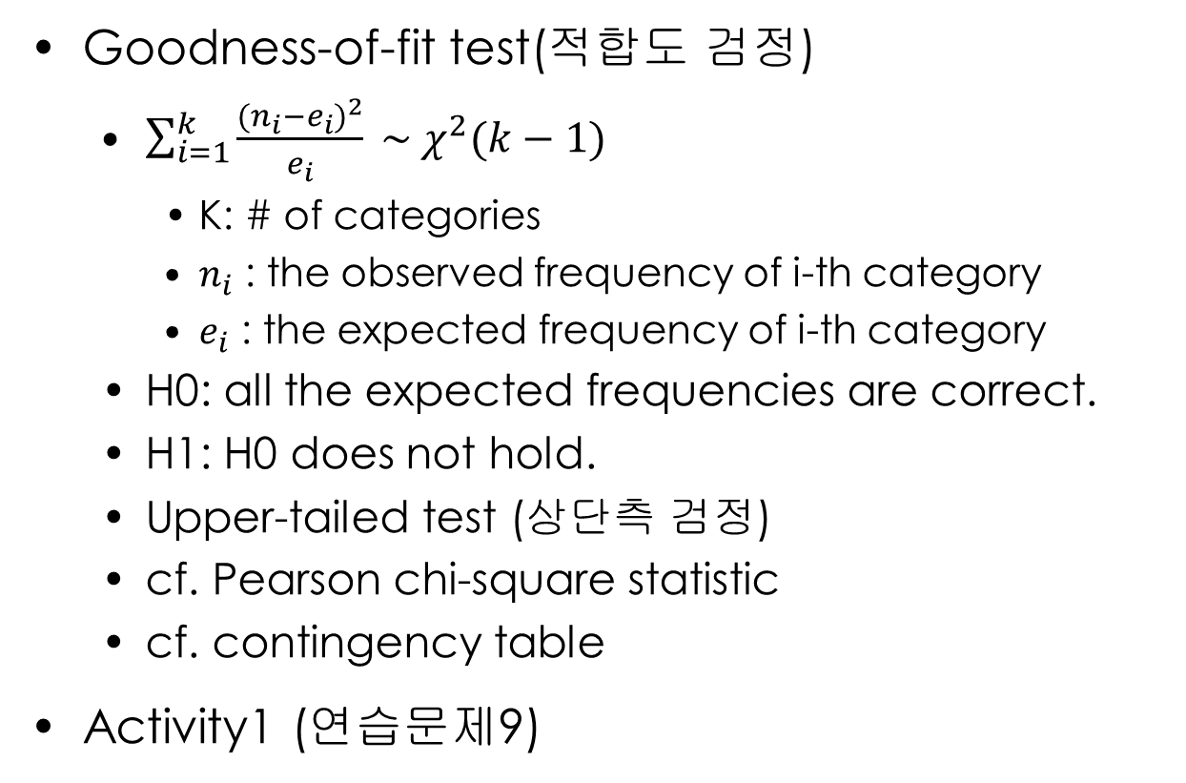
9.4 $χ^{2}$ Testing and Population Variance Testing(카이제곱 검정과 모분산 검정)
Goodness-of-fit test(적합도 검정)
$\sum_{i=1}^{k}{\frac{{(n_{i}−e_{i})}^{2}}{e_{i}} \sim χ^{2}(k−1)}$
K: # of categories
$n_{i}$ : the observed frequency of i-th category
$e_{i}$ : the expected frequency of i-th category
H0: all the expected frequencies are correct.
H1: H0 does not hold.
Upper-tailed test (상단측 검정)
cf. Pearson chi-square statistic
cf. contingency table
Activity1 (연습문제9)

